Slide 1
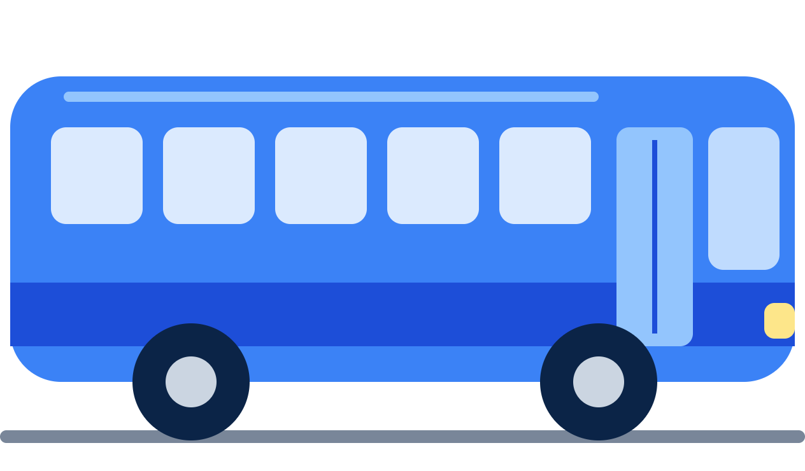
Bus Booking System
WEB DEVELOPMENT · FULL-STACK WEB APPLICATION
A web-based application for online bus ticket reservation
Search buses
Select seats
Pay online
Download ticket
Presented by Manoj C
Notes:
Good morning everyone. I am Manoj C, and today I will present my project, the Bus Booking System. It is a full-stack web application that lets travellers search for buses, choose seats, pay online and download their ticket.

Slide 2
Simple online bus booking
INTRODUCTION
1
Register and log in
The Bus Booking System is a web-based application designed to simplify the process of booking bus tickets.
2
Search buses by route
3
Select available seats
Users can register, log in, search for buses by source and destination, select available seats, and pay online using different payment methods. After successful payment confirmation, the system generates a ticket that users can download.
4
Pay online
5
Download the ticket
Bus Booking System · Manoj C
2 / 20
Notes:
The Bus Booking System simplifies ticket booking. A user registers, logs in, searches for buses on their route, picks seats, pays online by their preferred method, and finally downloads the ticket. These five steps are exactly what I will walk you through today.

Slide 3






What the project aims to achieve
OBJECTIVES
Make bus ticket booking easy and fast.
Show real-time bus and seat availability.
Offer secure user registration and login.
Support UPI, debit/credit cards, and net banking.
Generate downloadable tickets after successful payment.
Reduce manual work and prevent duplicate seat bookings.
Bus Booking System · Manoj C
3 / 20
Notes:
There are six objectives: make booking fast and easy, show live seat availability, keep registration and login secure, support UPI, cards and net banking, generate a downloadable ticket after payment, and avoid duplicate seat bookings by removing manual work.

Slide 4



The full-stack toolkit
TECHNOLOGIES USED
Frontend
Backend
Database
Payment
HTML, CSS, JavaScript, React
Node.js, Express.js
MongoDB
Razorpay or similar gateway
Business logic, authentication, bookings, and payment status.
Stores user details, buses, seats, bookings, and tickets.
User interface, forms, bus search, and seat selection.
Processes online payments and verifies the payment result.
Bus Booking System · Manoj C
4 / 20
Notes:
The frontend uses HTML, CSS, JavaScript and React for the screens. The backend is Node.js with Express.js for the business logic, login and bookings. MongoDB stores users, buses, seats, bookings and tickets, and a payment gateway such as Razorpay handles the money. Note for Manoj: keep only the technologies you actually used.

Slide 5


How the layers work together
SYSTEM ARCHITECTURE
User
The user works in the browser frontend. The Express API processes each request and reads or writes MongoDB. At checkout, the payment gateway handles the payment, and only a verified success confirms the booking.
Traveler using a web browser
Presentation layer
React · HTML · CSS · JavaScript — Register, Login, Search, Seats
EXTERNAL PAYMENT SERVICE
Application layer
UPI · Cards · Net Banking
Node.js · Express.js REST API — Auth, Booking, Seat Locking
The gateway returns a verified success or failure status.
Database layer
MongoDB — Users, Buses, Schedules, Seats, Bookings, Tickets
Bus Booking System · Manoj C
5 / 20
Notes:
Read the diagram from top to bottom. The traveler uses the React frontend, which calls the Node and Express REST API. The API handles authentication, bookings, seat locking and payment verification, and stores everything in MongoDB. On the right, the external payment gateway processes UPI, card and net banking payments and reports success or failure back to the API.

Slide 6












From login to confirmed ticket
SYSTEM FLOW
Start
Register / Login
Dashboard
Search Bus
Select Bus
Select Seat
Successful
Select Payment Method
Proceed to Payment
Enter Passenger Details
Payment Status?
Failed
Generate & Download Ticket
Confirm Booking
Show Failure Message
Retry Payment
Important: A failed or pending payment must not produce a confirmed ticket. The system verifies the payment result with the gateway before confirming the booking.
Bus Booking System · Manoj C
6 / 20
Notes:
Follow the top row left to right: start, register or log in, dashboard, search, select a bus, select a seat. Then the second row runs right to left: passenger details, proceed to payment, choose a method, and the decision point. If the payment is successful we confirm the booking and generate the ticket. If it fails we show a message and let the user retry. A failed or pending payment never produces a confirmed ticket.

Slide 7
The main page after login
SCREEN 1 · DASHBOARD
Everything a traveler needs, in one place.
busbooking.app/dashboard
Search buses by source and destination
Select the journey date
View popular routes and available buses
Open My Bookings and download tickets
View booking status and user profile
Log out securely
Bus Booking
My Bookings
Profile
Logout
From
To
Date
Trichy
Chennai
25/10/2026
Search Buses
Example: Trichy → Chennai · 25/10/2026
Popular routes
Chennai → Bengaluru
Trichy → Chennai
Madurai → Coimbatore
Bus Booking System · Manoj C · Illustrative UI with sample data
7 / 20
Notes:
After logging in, the user lands on the dashboard. From here they enter the source, destination and journey date and press Search Buses. They can also see popular routes, open My Bookings to download tickets, check their profile and log out. This screen is an illustration; replace it with a real screenshot of your project if you have one.

Slide 8
New users create an account
SCREEN 2 · REGISTRATION
Fields
busbooking.app/register
Full name
Email address
Mobile number
Password
Create your account
Confirm password
Full name
Process
Email address
User enters the required information
The system validates the form
The password is securely hashed
User details are saved in the database
Successful registration redirects to login
Mobile number
Password
Confirm password
Register
Bus Booking System · Manoj C · Illustrative UI with sample data
8 / 20
Notes:
New users register with their name, email, mobile number and a password. The system validates the form, hashes the password so it is never stored as plain text, saves the user in the database and then sends the user to the login page.

Slide 9
Secure sign-in for registered users
SCREEN 3 · LOGIN
Users log in with their email address and password.
busbooking.app/login
Email and password authentication
Input validation and error messages
Forgot password option
Secure session or token management
Redirect to the dashboard after login
Welcome back
Incorrect email or password
Email address
If the login details are incorrect, the system displays an error message.
Password
Forgot password?
Login
New user? Register
Bus Booking System · Manoj C · Illustrative UI with sample data
9 / 20
Notes:
Registered users log in with their email and password. The system validates the input, shows a clear error message if the details are wrong, offers a forgot password option and uses a secure session or token. After a successful login the user is redirected to the dashboard.

Slide 10
Find buses for a journey
SCREEN 4 · SEARCH BUS
Search fields
busbooking.app/search
From city
To city
Journey date
Trichy → Chennai · 25/10/2026
Each result shows
Blue Line Express
₹450
Bus name and type
Departure and arrival times
Journey duration
Ticket price
Available seats
A Select Bus button
AC Sleeper · 06:00 → 10:30 · 4h 30m
28 seats available
Select Bus
City Star Travels
₹320
Non-AC Seater · 09:15 → 14:00 · 4h 45m
17 seats available
Select Bus
Only buses matching the selected route and date are shown.
Sunrise Express
₹520
AC Seater · 22:30 → 03:15 · 4h 45m
35 seats available
Select Bus
Bus Booking System · Manoj C · Illustrative UI with sample data
10 / 20
Notes:
The user enters the from city, to city and journey date. The results list only the buses that match that route and date, with the bus name and type, departure and arrival times, duration, price and number of seats left. The bus names and prices on this slide are sample data for illustration.

Slide 11
Compare and choose a bus
SCREEN 5 · SELECT BUS
After searching, users compare the options and pick their preferred bus.
busbooking.app/bus/details
Bus details
Blue Line Express
AC Sleeper
Bus operator and bus type
Departure and arrival locations
Travel time
Ticket price
Seat availability
06:00
10:30
4h 30m
Trichy
Chennai
₹450 per seat
28 seats available
Select Bus →
Clicking Select Bus opens the seat selection page for that bus and schedule.
City Star Travels
₹320
Non-AC Seater · 09:15 → 14:00
Bus Booking System · Manoj C · Illustrative UI with sample data
11 / 20
Notes:
Here the user compares the buses. Each option shows the operator and bus type, departure and arrival places and times, travel time, price and seats left. When the user clicks Select Bus, the seat selection page opens for that exact bus and schedule.

Slide 12
Pick seats on a visual layout
SCREEN 6 · SELECT SEAT
Available
Selected
Booked
busbooking.app/seats
View available and booked seats
Select one or more seats
Show the selected seat numbers
Calculate the total ticket amount
Temporarily lock selected seats during checkout
Prevent two users from booking the same seat
FRONT
Your selection
1A
1B
1C
1D
Seats: 3A, 3B
2A
2B
2C
2D
₹450 × 2 seats
Total ₹900
3A
3B
3C
3D
Seats are held while you pay
4A
4B
4C
4D
5A
5B
5C
5D
Continue
6A
6B
6C
6D
Bus Booking System · Manoj C · Illustrative UI with sample data
12 / 20
Notes:
This is the seat selection page. White seats are available, blue seats are the ones I have selected, and grey seats are already booked. The total updates as seats are picked. Once a seat is selected it is temporarily locked during checkout, so two users can never book the same seat.

Slide 13
Passenger details and review
SCREEN 7 · BOOKING SUMMARY
Passenger details
Booking summary
Passenger name
Bus | Blue Line Express
Route | Trichy → Chennai
Journey date | 25/10/2026
Seats | 3A, 3B
Passengers | 2
Total amount | ₹900
Age
Gender
Contact number
Email address
Entered for every passenger before payment.
Proceed to Payment
Bus Booking System · Manoj C · Illustrative UI with sample data
13 / 20
Notes:
Before payment, the user enters the passenger name, age, gender, contact number and email. On the right is the booking summary: bus, route, date, selected seats, number of passengers and total amount. The user checks everything and clicks Proceed to Payment.

Slide 14

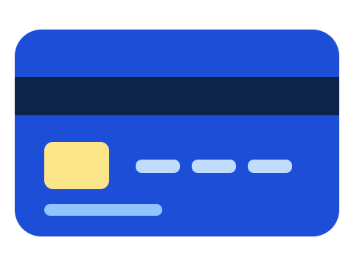

Three ways to pay online
SCREEN 8 · PAYMENT METHOD
1. UPI Payment
2. Card Payment
3. Net Banking
Pay through a supported UPI app or QR code using an integrated payment gateway.
Pay with an eligible debit or credit card through the gateway's secure checkout.
Choose a supported bank and complete payment through the bank's authorization process.
Pay Now
After choosing a payment method, the user clicks Pay Now to start the transaction.
Bus Booking System · Manoj C
14 / 20
Notes:
The system offers three online payment methods. UPI works through a supported UPI app or a QR code. Cards are processed through the gateway's secure checkout. Net banking sends the user to their bank for authorization. After choosing a method, the user clicks Pay Now to start the transaction.

Slide 15


Payment successful or failed
SCREEN 9 · PAYMENT RESULT
Payment Successful
Payment Failed
Verify the payment with the gateway
Confirm the booking
Mark the seats as booked
Generate the ticket
Display the failure message
Keep the booking unconfirmed
Allow the user to retry payment
Release expired seat locks safely
Payment workflow: The backend verifies the transaction through the gateway's payment confirmation or signed notification. Only a verified successful payment changes the booking to confirmed.
Pending payment: The system waits for confirmation instead of showing success or failure right away.
Bus Booking System · Manoj C
15 / 20
Notes:
This is the most important rule in the system. If the payment is successful, the backend first verifies it with the gateway, then confirms the booking, marks the seats as booked and generates the ticket. If the payment fails, the booking stays unconfirmed, the user can retry, and expired seat locks are released. If the payment is still pending, the system waits for confirmation instead of guessing.

Slide 16
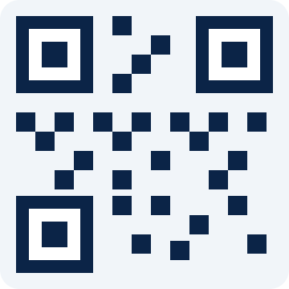
Download the e-ticket
SCREEN 10 · CONFIRMED BOOKING
The ticket contains
Bus Ticket
PAID · CONFIRMED
Unique booking ID or PNR
Passenger name
Bus operator and bus details
Source and destination
Journey date and departure time
Seat number
Payment status
QR code or verification code, if implemented
PNR
Passenger
BB-251025-0042
A. Kumar
Route
Journey date
Trichy → Chennai
25/10/2026
Departure
Seat
06:00
3A
Bus
Payment
The ticket becomes available only after the booking is confirmed.
Blue Line Express
Successful
Download PDF
View Ticket
Print Ticket
Bus Booking System · Manoj C · Illustrative UI with sample data
16 / 20
Notes:
Once the payment is verified, the system generates the e-ticket. It carries a unique PNR, the passenger name, bus details, route, date and departure time, seat number, payment status and optionally a QR code. The user can download it as a PDF, view it, print it, or find it again under My Bookings. The ticket exists only after the booking is confirmed. The passenger name and PNR shown are sample values.

Slide 17

What the system stores
DATABASE DESIGN
Collection | Main data
Users | User ID, name, email, password hash
Buses | Bus ID, operator, type, seat layout
Schedules | Bus ID, route, date, departure time
Seats | Seat ID, schedule ID, status
Bookings | Booking ID, user ID, seats, amount, status
Payments | Payment ID, booking ID, method, status
Tickets | Ticket ID, booking ID, PNR, details
How the data connects
User
Booking
Payment
Ticket
Relationship: A user can make multiple bookings. Each booking contains selected seats and a payment record. A confirmed booking can have a generated ticket.
Bus Booking System · Manoj C
17 / 20
Notes:
The database has seven collections: users, buses, schedules, seats, bookings, payments and tickets. On the right you can see how they connect. One user can make many bookings. Each booking holds its seats and has a payment record, and a confirmed booking can have a generated ticket.

Slide 18


Why this system helps travelers
ADVANTAGES
Convenient online ticket reservation
Faster booking process
Multiple payment options
Clear view of seat availability
Fewer manual errors and duplicate bookings
Easy ticket download and retrieval
Accessible through a web browser
Simple, fast, and reliable ticket booking
Bus Booking System · Manoj C
18 / 20
Notes:
The main advantages: booking is convenient and fast, there are several payment options, seat availability is clearly visible, manual errors and duplicate bookings are reduced, tickets are easy to download and find again, and everything works in a web browser.

Slide 19
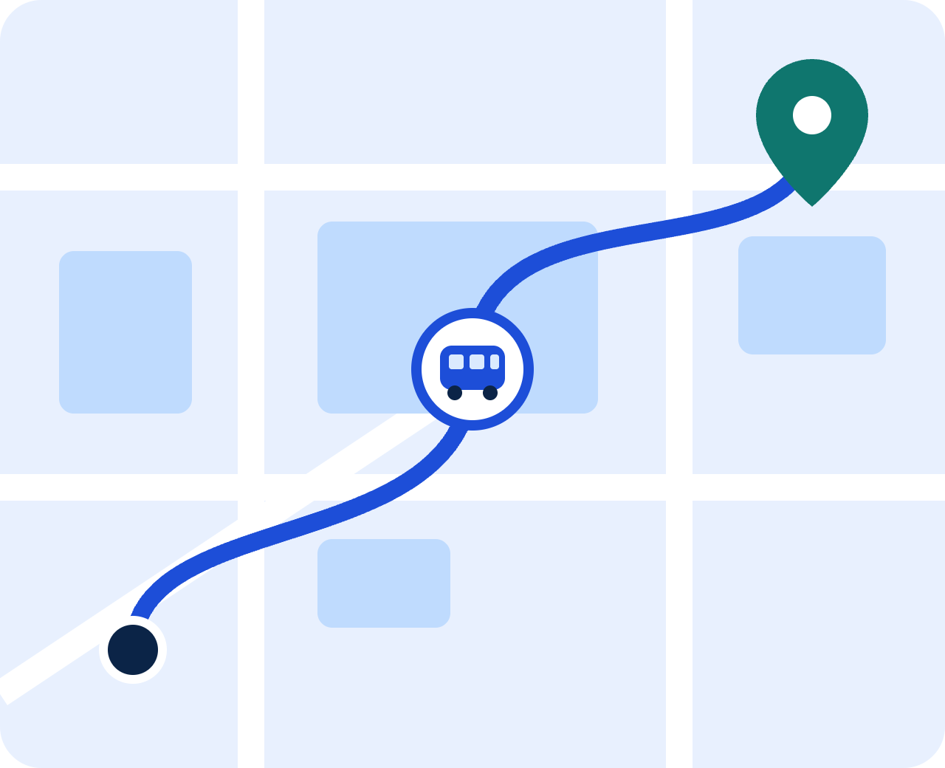
What can be added next
FUTURE ENHANCEMENTS
1
Live bus tracking using GPS
2
Email and SMS booking notifications
3
Booking cancellation and refunds
4
Ratings and reviews for bus operators
5
Admin dashboard for routes and schedules
6
Offers, coupons, and discounts
7
Better accessibility and mobile responsiveness
Bus Booking System · Manoj C
19 / 20
Notes:
There is plenty of room to grow. Live GPS tracking is shown on the map. Other ideas are email and SMS notifications, cancellation and refunds, ratings and reviews, an admin dashboard to manage routes and schedules, offers and coupons, and better accessibility and mobile responsiveness.

Slide 20
A complete booking journey in one web application
CONCLUSION
Thank You
The Bus Booking System provides a simple and efficient way to reserve bus tickets online. It integrates user authentication, bus searching, seat selection, online payment, booking confirmation, and electronic ticket generation.
Questions?
Manoj C
This project demonstrates practical web development skills, database integration, backend API development, and payment workflow management.
Notes:
To conclude, the Bus Booking System brings login, bus search, seat selection, online payment, booking confirmation and e-ticket generation together in one web application. It shows practical web development, database, backend API and payment workflow skills. Thank you, and I am happy to take any questions.

